Slide 1
Exploratory Data Analysis on Cancelations of Hotel Reservations
Blaine Bristow

Slide 2
Hypothesis
A dataset containing hotel reservation data will be observed to determine trends regarding the number of occupants, length of stay, price of room, and whether the reservation was cancelled or not.
From these variables, the most intriguing to hotel owners would likely be if any correlations can be determined regarding cancellations. If certain criteria are more likely to be cancelled, perhaps the business can attempt to reduce cancellations by adjusting room offerings.

Slide 3
Variables
Adults (no_of_adults)
Numeric field. Number of adults booked for the stay.
Children (no_of_children)
Numeric field. Number of children booked for the stay.
Weekend (no_of_weekend_nights)
Numeric field. Number of weekend nights (Saturday and Sunday) that the room is reserved for.
Weekday (no_of_week_nights)
Numeric field. Number of week-nights (Monday through Friday) that the room is reserved for.
Price (avg_price_per_room)
Numeric field. Price of the room taken as an average over the number of nights stayed. Prices are in Euros.
Status (booking_status)
Boolean field. Whether the reservation was cancelled or not.

Slide 4
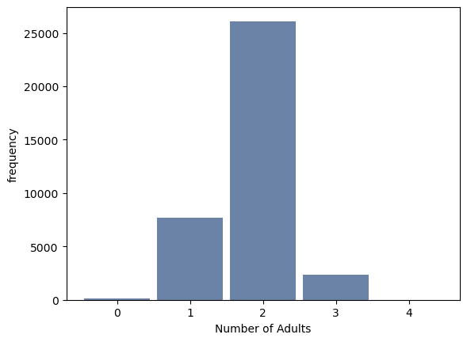
Adults
Outliers
Bookings with 0 or 4 adults are rare, but not outside the bounds of being reasonable data. These should not be dropped.
Mean
The mean number of adults is 1.84.
Mode
The mode can be visually identified as 2 adults per booking.
Spread
With a maximum value of 4 and a minimum value of 0, the spread of Adults is 4.
Tails
With only a handful of values, it’s hard to definitively say visually, but this appears to be roughly symmetric. A slight right tail could be considered due to the much greater presence of 1 adult than 3.

Slide 5
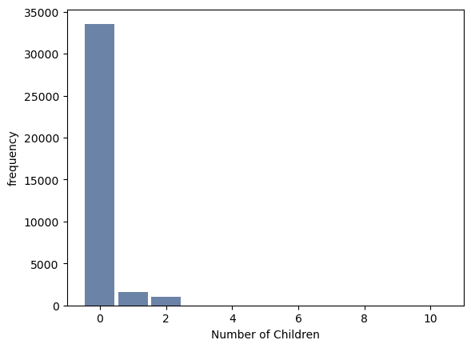
Children
Outliers
Of 36k rows, 19 include 3 children, 2 include 9 children, and 1 includes 10 children. While 3 children in one room seems to be rare, it’s not unreasonable. Rooms containing 9 or 10 children can be considered outliers and tossed; perhaps this was mis-input data.
Mean
The mean number of children is 0.51.
Mode
The mode can be visually identified as 0 children.
Spread
With a maximum value of 10 and a minimum value of 0, the spread of Children is 10.
Tails
With a vast majority of bookings containing 0 children, this histogram is clearly right-skewed.

Slide 6
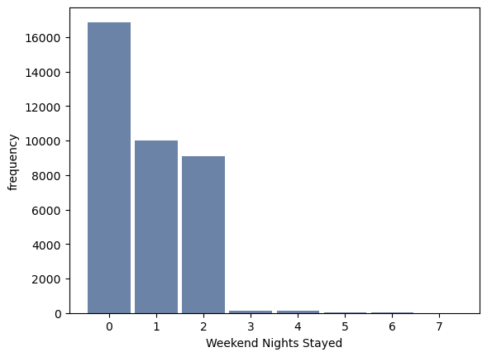
Weekend
Outliers
Most stays don’t extend from one weekend through the next, so any stay including 3+ weekend nights is rare. Conservatively, stays including 5+ weekend nights could be considered outliers.
Mean
The mean number of weekend nights is 0.81.
Mode
The mode can be visually identified as 0 weekend nights.
Spread
With a maximum value of 7 and a minimum value of 0, the spread of Weekend is 7.
Tails
With most bookings going through 0 weekend nights, this histogram is clearly right-skewed.

Slide 7
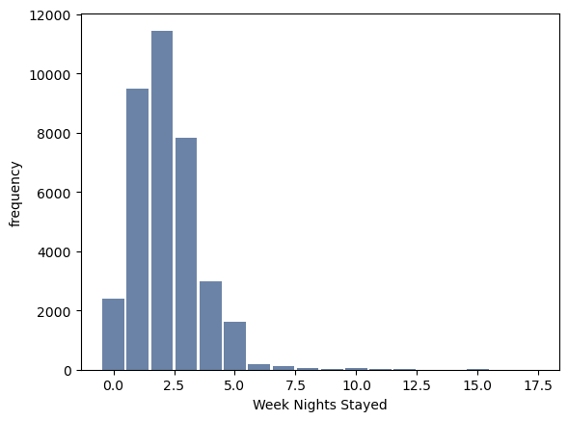
Weekday
Outliers
Once again, stays longer than 1 week are quite rare. Following the trend set regarding the Weekend data, any stay including 11+week-nights could be considered an outlier.
Mean
The mean number of weekday nights is 2.20.
Mode
The mode can be visually identified as 2 weekday nights.
Spread
With a maximum value of 17 and a minimum value of 0, the spread of Weekday is 17.
Tails
While not as strongly as the previous 2 variables discussed, Weekday is right-skewed.

Slide 8
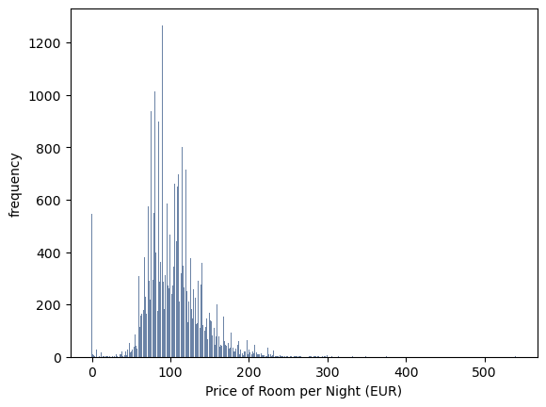
Price
Outliers
There are about 550 free rooms that can be considered outliers and likely bad data. There are a handful of cheap and expensive rooms (<20 or >300 Euros/night) that may be considered outliers as well.
Mean
The mean value for price is 103.42 Euros.
Mode
The actual mode is 65.00 Euros. However, the histogram uses rounded-down prices to increase readability. Visually, the mode of this histogram is approximately 90 Euros.
Spread
With a maximum value of 540.00 and a minimum value of 0.00, the spread of Price is 540 Euros.
Tails
Once again, the histogram displays a right skew, although it is not a very strong skew.

Slide 9
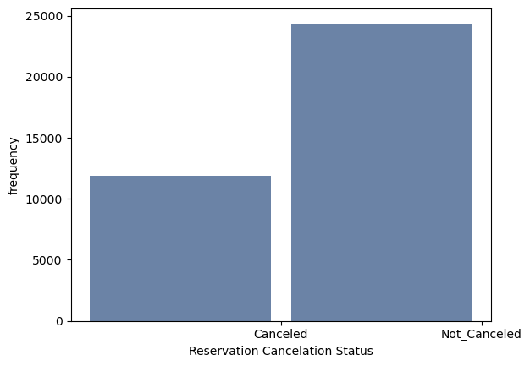
Status
As a Boolean variable, this isn’t really a histogram that can be evaluated like the previous 5 variables. This is only being included to show that there is a reasonable spread of data. About a third of the data represents bookings that were cancelled.

Slide 10
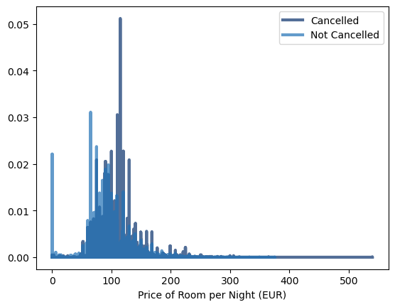
PMF comparing prices based on status
A graph displaying the probability mass function of the average price per room for bookings that were cancelled and bookings that were fulfilled was created to attempt to visually determine if more expensive rooms tended to be cancelled more often than cheaper rooms.
It appears that yes, rooms more expensive than 100 Euros per night tend to be cancelled somewhat often, but rooms under 100 Euros per night aren’t cancelled as often
The large spike in cancellations around 110 Euros should be investigated further, as rooms of that price appear to have an unusually high cancellation rate.

Slide 11
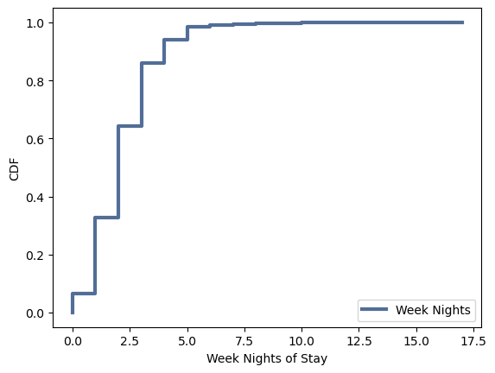
CDF showing length of stay (Weekday)
A graph displaying the cumulative distribution function of the length of stay in weekdays was created to show the probability that a stay is less than or equal to any given number of weeknights.
For example, from the graph, it can be determined that about 90% of stays are a week or less, and 99% are 2 weeks or less.

Slide 12
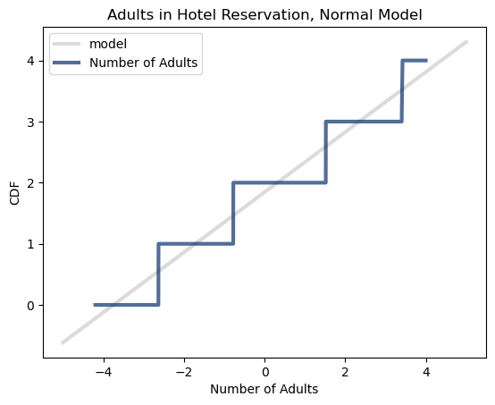
Normal Probability Plot
As it was one of the variables closest to normal, a normal probability plot of the number of adults in a booking was compared to a normal model.
Although the function comes out quite stair-step due to the few potential responses returned by Adults, it can be observed that it follows the normal model well, excepting the rooms with the most adults, which exceed the model.

Slide 13
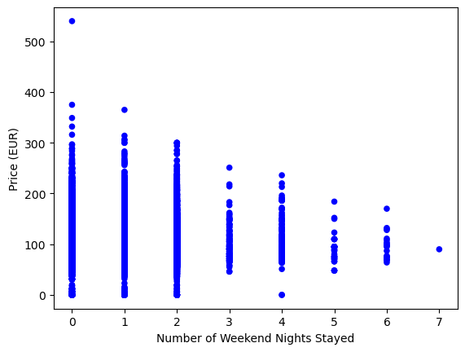
Correlation Between Weekend and Price
A scatterplot was created for Price and Weekend. The initial assumption was that as nights increased, the price would decrease. However, the plot has a funnel shape. This does make sense, if someone is spending a long time in a hotel, they’ll likely be going for something affordable but quality.
Due to the funnel shape, it’s not expected that there will be a strong correlation between the 2, as a central price is reached as the number of nights increases. This can be observed in the values calculated below:
Covariance: -0.19
Correlation: -0.01
Spearman Correlation: -0.03

Slide 14
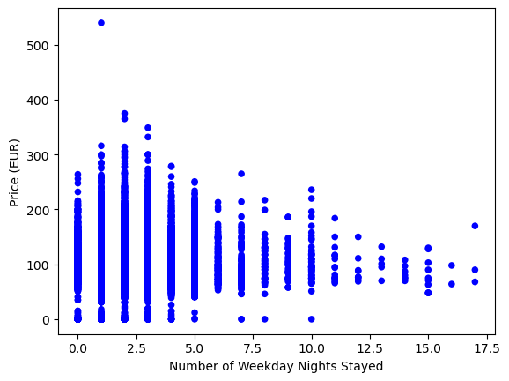
Correlation Between Weekday and Price
Another scatterplot was created for Weekday and Price, similar to the previous plot. Once again, it was initially expected that price would decrease with number of nights, but perhaps the greater number of available nights would provide a stronger correlation.
However, the correlation between the values was once again quite low due to the price approaching a central value.
Covariance: 1.03
Correlation: 0.02
Spearman Correlation: 0.02

Slide 15
Permutation test
A permutation test was run to determine the if the difference in means between Price for bookings that have been cancelled and bookings that have not is due to random sampling.
A p-value of 0.0 was returned, suggesting that the null hypothesis can be rejected, and the difference is not the result of random sampling.

Slide 16
Least Squares Multiple Regression
A least squares multiple regression was run for all variables observed in this analysis. The cancellation status was treated as the dependent and all others were treated as explanatory.
Cancelled bookings were treated as 1 and not cancelled as 0.
From this it was observed that there was a positive correlation in cancellations with Price, Adults, Weekend, and Weekday, and a negative correlation with Children, although the correlation may be weak.
 | Price | Adults | Children | Weekend | Weekday
Coefficient | 0.0018 | 0.0300 | -0.0182 | 0.0243 | 0.0262
P>|t| | 0.000 | 0.000 | 0.005 | 0.000 | 0.000

